Slide 1
HELPS WELFARE SOCIETY REGD. NO. 121 OF 2016-17 .
H- HEALTH
E- EDUCATION
L- LIBERTY
P- PEACE
S- SERVICE
Regd. No- 121, A Registered N.G.O.
N.G.O. Registered Under Society Registration ACT XXI of 1860

Slide 2
HELPS WELCOME YOU ALL
“WE ARE HERE TO HELP, WE ARE HELPS WELFARE SOCIETY”

Slide 3
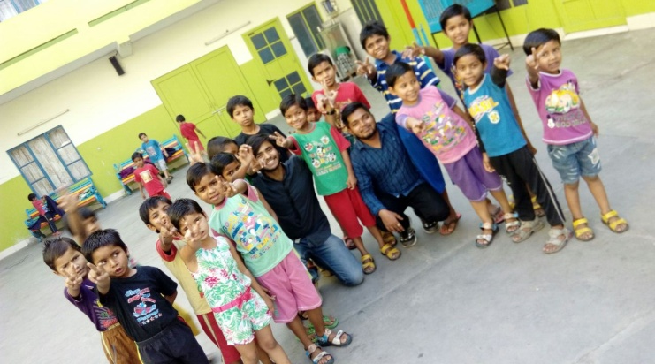
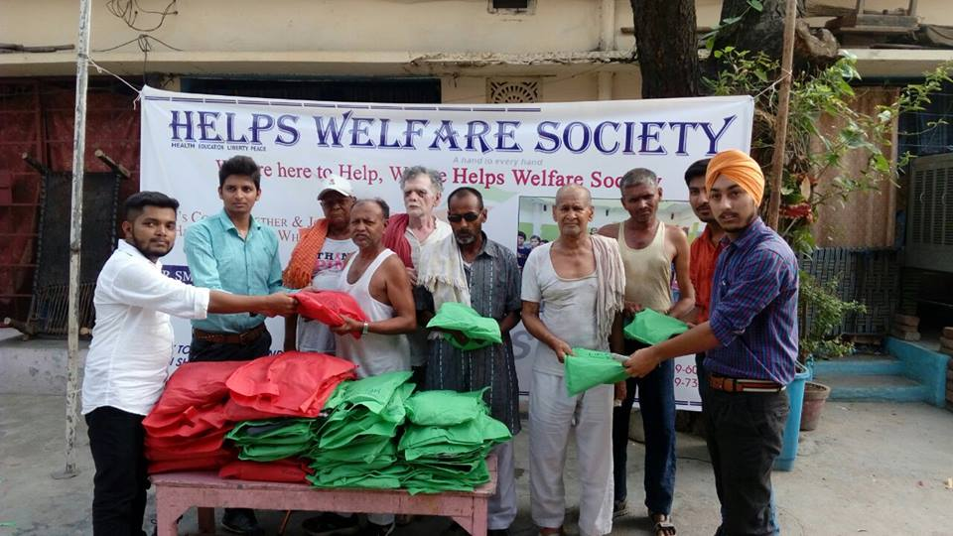
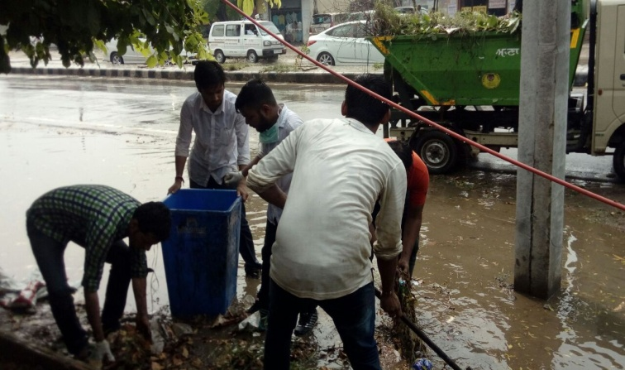
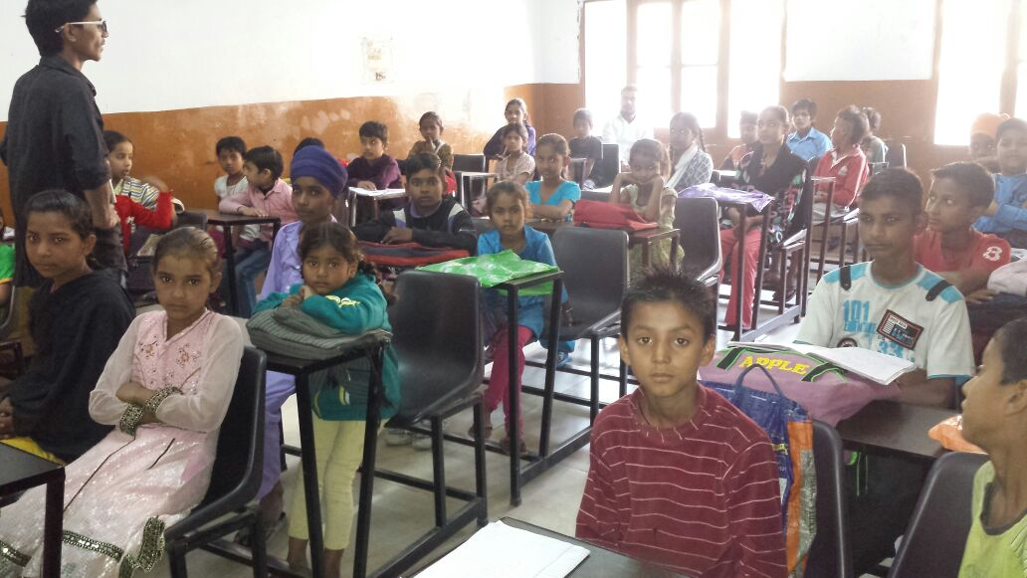
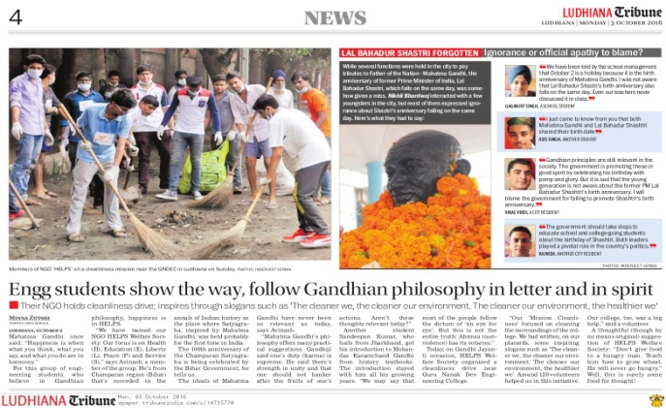
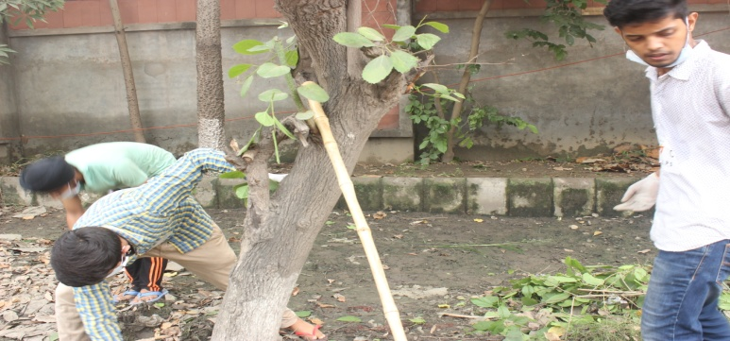
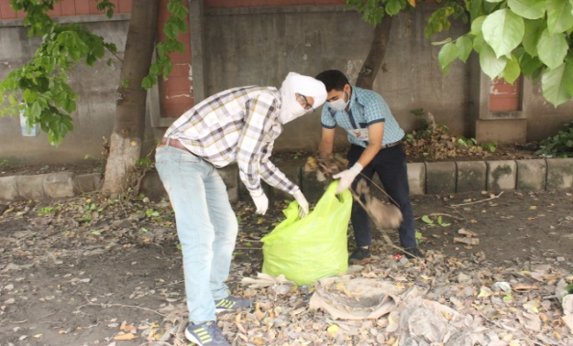
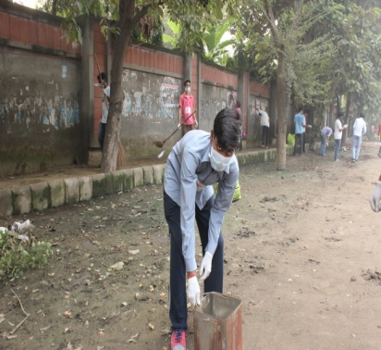
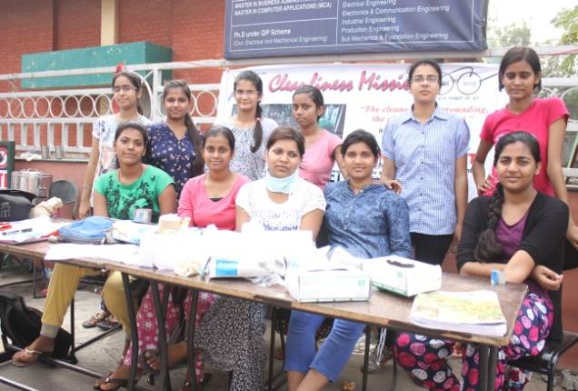
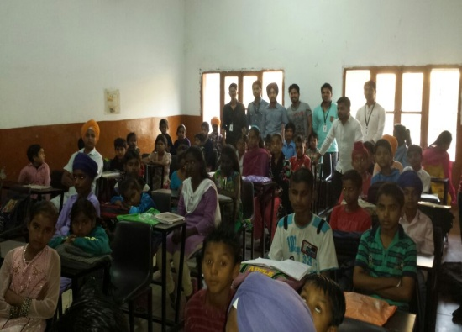
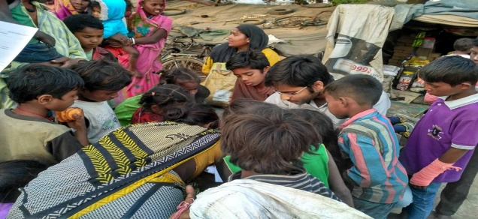
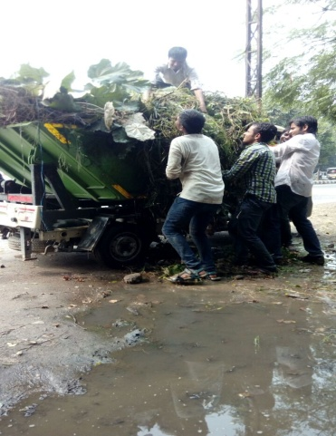
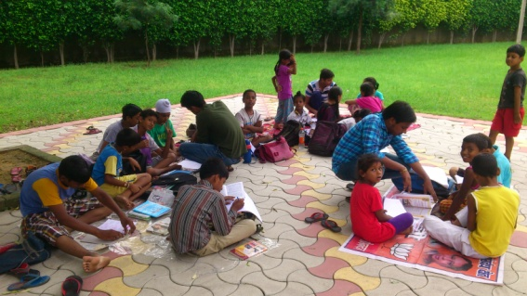
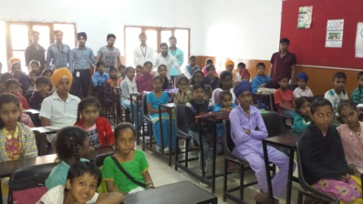
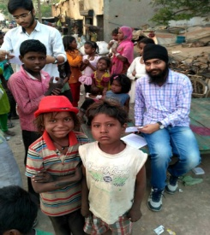

Slide 4
HELPS
It’s a youth organization, made for helping and welfare purpose. We are students of G.N.D.E.C. Ludhiana with charitable motive. Our main motive is to help the needy people.

Slide 5
OUR VISION
Our vision is to make a better India which provides basic Health, Education, Liberty, Peace & Empowerment to every citizen.
To create a child friendly society, where all children are free from exploitation and receive free and quality education.
Protection of environment and promote safe practices for preservation of eco-balance.

Slide 6
AIMS
CHILD EMPOWERMENT
Education to the handicapped, the poor and the marginalized children in rural areas, tribal villages and urban slums is a priority concern for HELPS.
ENVIRONMENTAL PROTECTION
Protection of environment and promote safe practices for preservation of eco-balance.

Slide 7
.
WOMEN EMPOWERMENT
This project will aim to provide good health for women in underprivileged section of society or backward areas by providing necessary medications supplements.
VASTRA ANUDAN
VASTRA ANUDAN is a campaign started by HELPS N.G.O. in India that aims to remove the plight of economically backward classes by providing clothes in every winter.

Slide 8
CHILD EMPOWERMENT
They should be well educated and healthy. OUR VISION IS TO STRETHEN THIS PILLAR OF OUR COUNTRY, as they are the future of our country.
How can we do?
Awareness (posters, seminars, nukkar natak, camps , etc.)
Aware the guardians about free education and free facilities given by govt.
All the children of age 14 or below should go to schools ( amendment 86th of Indian constitution).

Slide 10
Poor students
Motivate to study (parents and students).
Basic study needs (a) Guidance (b) Other study materials.
Where there is no quality study:-
Act as pressure groups .
(b) Teaching facilities by us( we can’t wait for the situation to be improved).
Help, guide to attain higher education
Free counseling to poor students who are interested for higher education.
Help and aware students to get their scholarship.

Slide 11
Education to the handicapped, the poor and the marginalized children in rural areas, tribal villages and urban slums is a priority concern for HELPS.
Education gives empowerment in employment areas, commercial activities, health care and in fact Total Quality of Life.
Awareness on child labor and child abuse.
To act as a pressure groups and aware people to get their ward healthy through aanganbadi kendra and provide basic health care if needed, by taking care of nutritional value, sanitation, hygiene etc.

Slide 12
AABHA- “EK NAYI KIRAN”
In our bid to tackle the crippling problem of high illiteracy rate in India , we launched AABHA program to form the basis of our work in the field of child empowerment. Under AABHA we are providing free quality education to underprivileged children.
AABHA started nearly three year ago, at that time we were providing free education to some 30 students inside the college premises of GNDEC.
At present we are providing free education to more than 150 underprivileged students inside the premises of Nankana Sahib Public School.
We are providing basic stationary to the students (books, copies, pen, pencil etc) by organizing an event of “STATIONARY DONATION”.

Slide 13
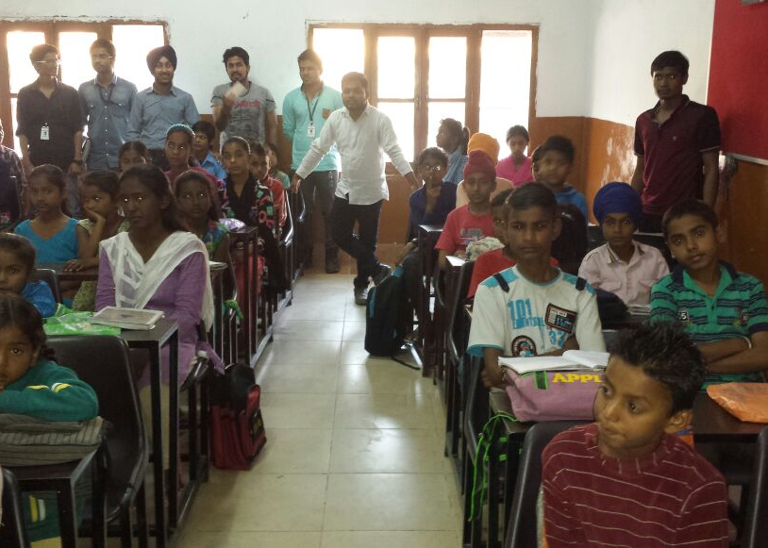
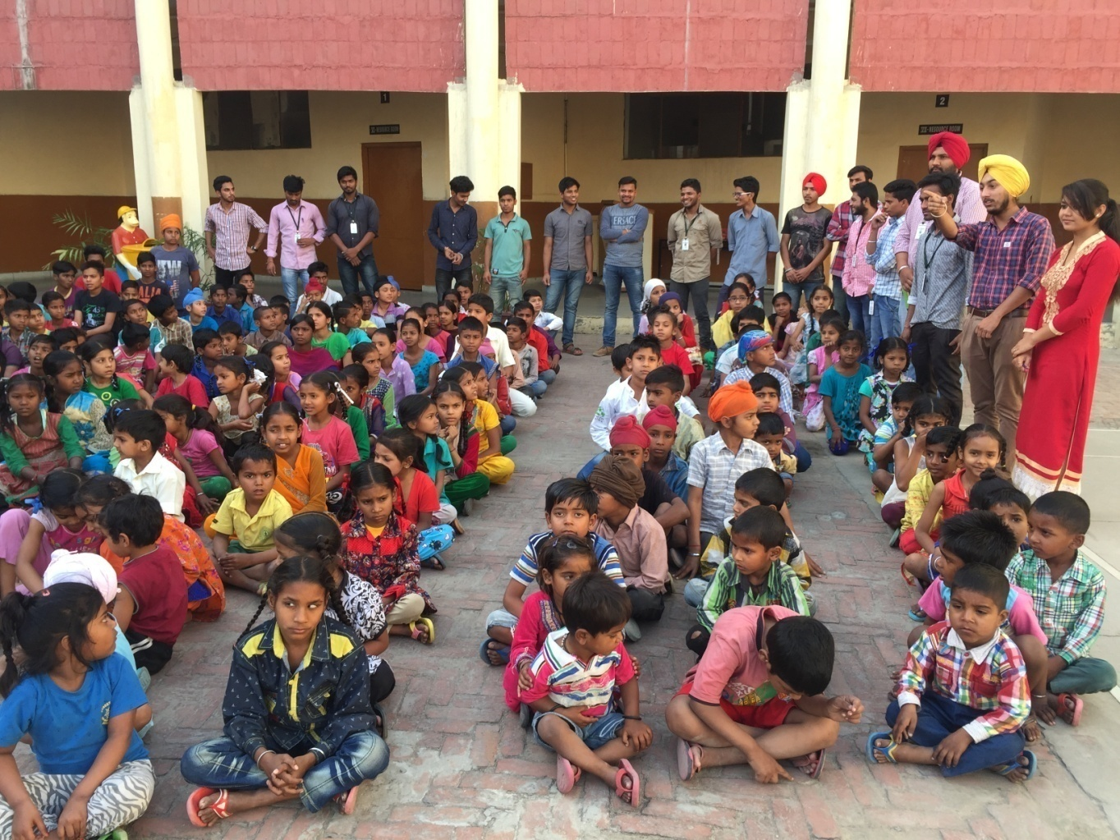
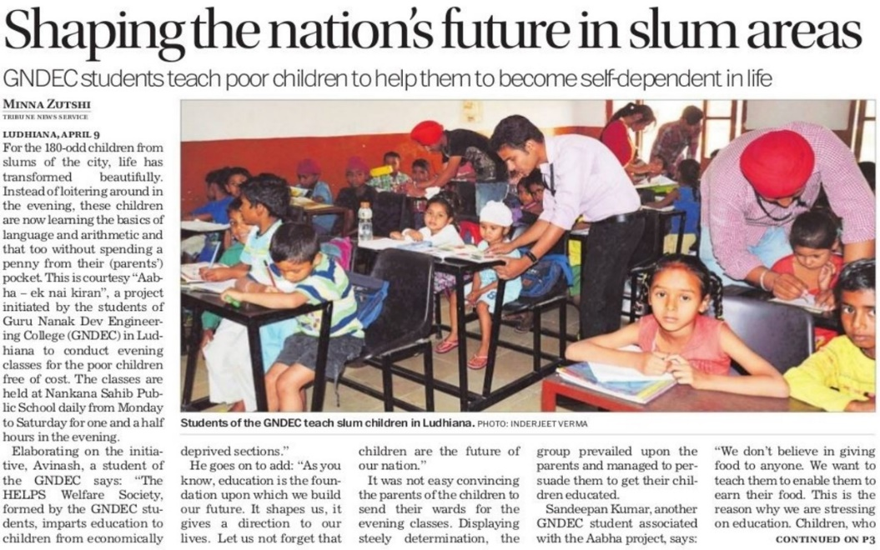

Slide 14
ENVIRONMENTAL PROTECTION
“ THE CLEAN WE ARE, THE CLEANER OUR ENVIRONMENT;
THE CLEANER OUR ENVIRONMENT, THE HEALTHIER WE”

Slide 15
ENVIRONMENTAL PROTECTION
The most important duty one should have towards this nature.
We are focussed to protect the environment by plantation, and forestation.
We will aware people to save water , to plant more and more trees.
Protection of environment and promote safe practices for preservation of eco-balance.

Slide 16
Source- WHO

Slide 17
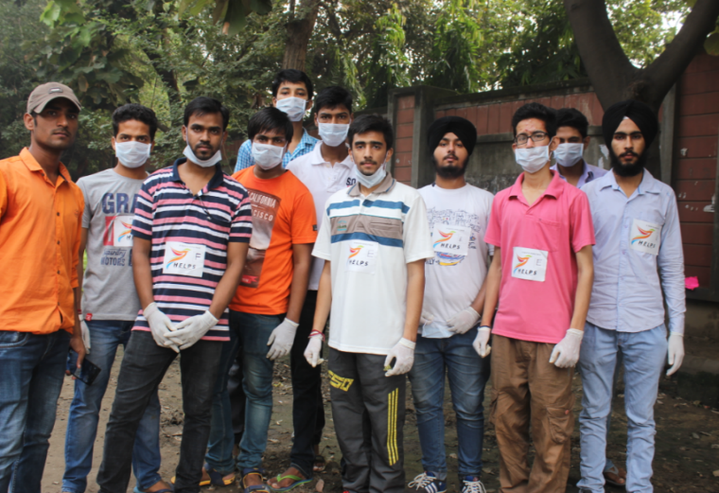
How we can achieved?

Slide 18
Volunteer Activity
Plantation and forestation.
Educate students of school to protect environment.
Promoting natural process for vegetation (ORGANIC FARMING).
Seminars in colleges, separation of recyclable and non recyclable wastes.
Promotion of public transport.
Promote and train for bio gas in rural areas ( just to stop wood and coal as fuels).
To aware the people towards environment.

Slide 19
WOMEN EMPOWERMENT
‘UTKALIT” ek-nayi-pahal a project on women empowerment started by HELPS Welfare Society. An initiative to support those who often are forgotten in course of life. As we know at the age of 40 plus, muscle mass starts to deteriorate, one may more likely to put on weight, menopause may (or may soon) start, and risk of chronic diseases like cancer, heart disease, and diabetes begins to increase. One of the best ways to stay healthy is by getting enough of the right vitamins and nutrients.
How we can achieved?
Under our UTKALIT project we organise a campaign of PRAYAS- ek kadam . Under which we aware underprivileged/slum area’s peoples about Hygiene during Mensuration cycle period’s, also we aware them the wrong effects of Meniac taboo among themselves. We also provide Sanitary pad’s as an initiative for their good health.

Slide 20
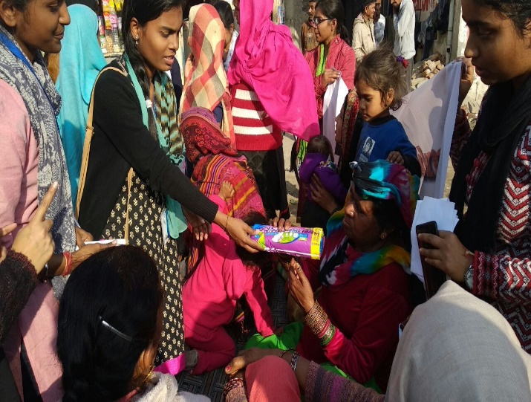
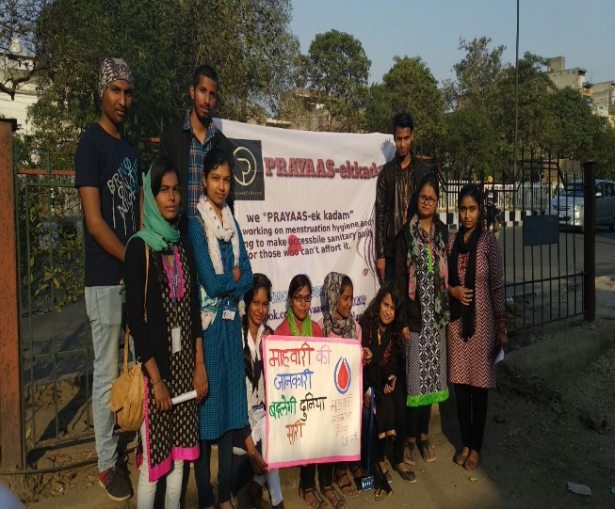
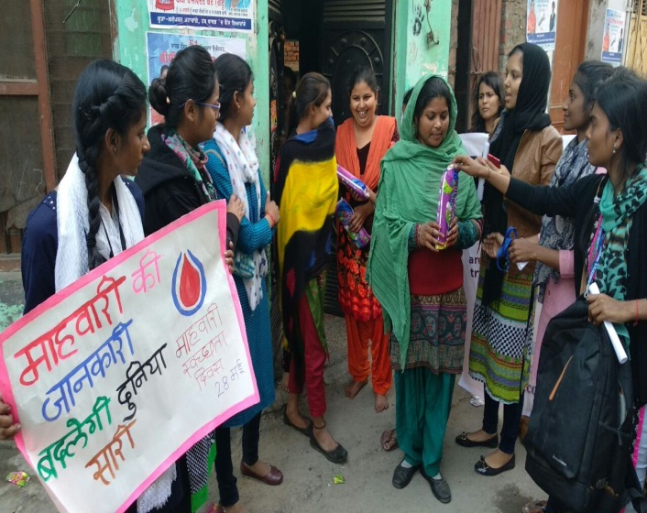
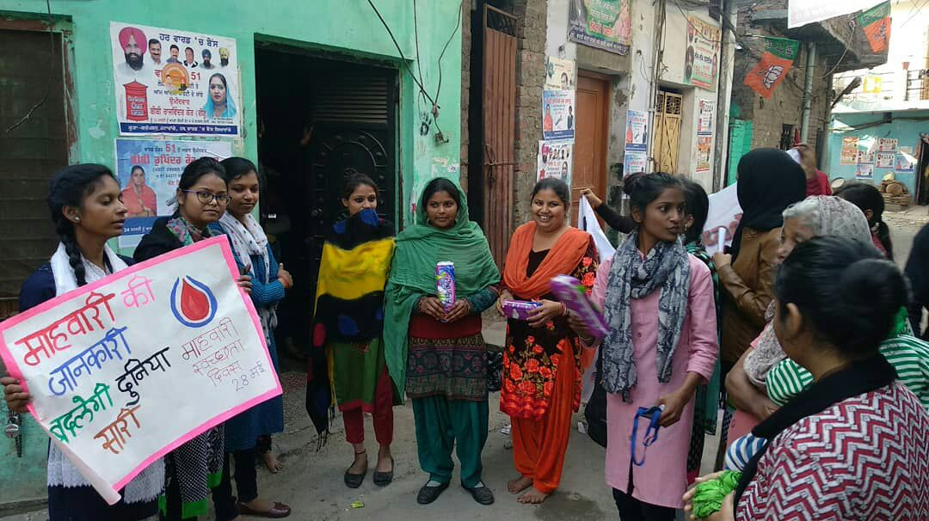
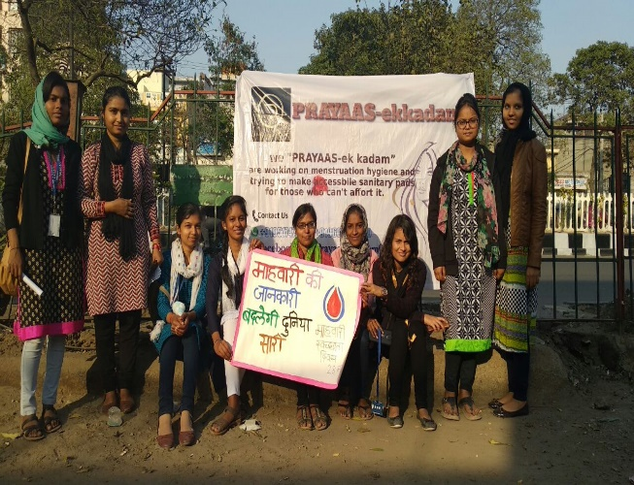
PICTORIAL REPRESENTATION OF OUR “UTKALIT” PROJECT

Slide 21
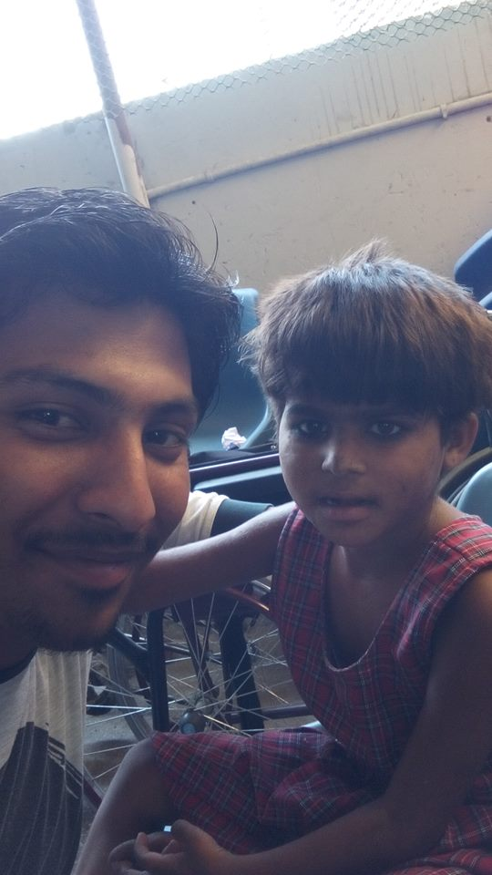
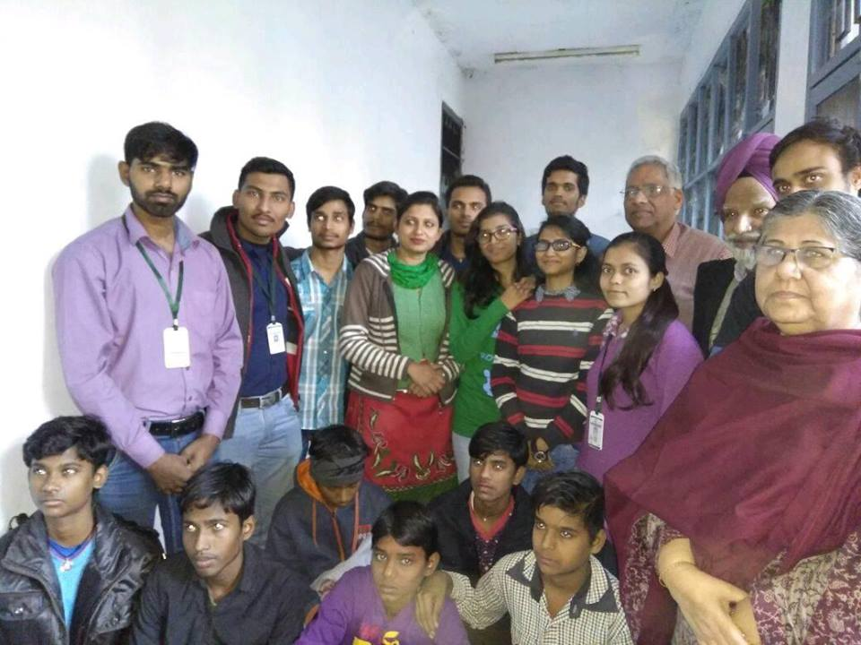
VASTRA ANUDAN
We had distributed clothes to poor and deprived people.
Visited orphanages and got their problem like educational needs.
. Thanks to Child protection officer Shukhveer Kaur Siddhu, Bachpan Bachao Andolan Punjab coordinator Dinesh Kumar and all other respected persons.

Slide 22
OUR AWARENESS POSTER

Slide 23
WHERE WE ARE ABLE TO DO WORK
Basic aims and objectives shall be:
Work for the welfare of common people through Health, Education, Liberty & Peace.
(To identify and work alongside the economically and socially deprived, the physically and mentally challenged - starting with children, so that they become educated, skilled and aware.
Enable them to be self-reliant and enjoy a healthy, dignified and sustainable quality of life).
Create awareness amongst citizens for their rights and privileges.
Help people to fight against social evils like corruption, Dowry, Ill-treatment of citizens by government departments/officials.
Protection of environment and promote safe practices for preservation of eco-balance.
Fight against all sources of pollution like air, water, noise etc.
Help elderly people and senior citizens in health care, protection and legal rights.
Educate people on rights about education, freedom and privileges granted under constitution.
Gather information under RTI act for eradication of corruption.
To expose malpractices adopted by educational institutions, Hospitals, Travel agents to safe guard interest of parents and general public.

Slide 24
There are many projects we want to launch.
To work on such projects we need your support.
Listen to the voices,
Be a HELPING Hand to such hands

Slide 25
* If you decide to join HELPS in building economically stronger communities in India, it would help you reach out to millions of poor people.
We seek a world of hope,
# 100% Literacy rate
# Health security
# Green INDIA

Slide 26
Student Internship
Students from various universities/ colleges/ institutes/ schools do their social internship with HELPS.
HELPS team is giving awareness, like protection of environment to students in Schools, Colleges and Institutions throughout India. Campaigns in Mass Media are taken up with all enthusiasm.

Slide 27
LET’S COME TOGHETER TO HELP THE NEEDY
“Do all the good you can, By all the mean you can, In all the ways you can;
In all the place you can, In all the times you can, To all the people you can;
As long as ever you can”

Slide 28
THANK YOU
Contact No.:- +91-9803054088
Find us on facebook:- fb.com/helpsngo
E-mail us on:- helpsngoteam@gmail.com

